Slide 1
Intro to HTML, CSS, JavaScript
Crash course for fundamental front end web development
Computing club, October 15, 2020
Notes:
https://learn.shayhowe.com/html-css/building-your-first-web-page/
https://internetingishard.com/html-and-css/introduction/
https://www.slideshare.net/AnaCidre/html-and-css-crash-course
Talk about how this is just for exposure

Slide 2
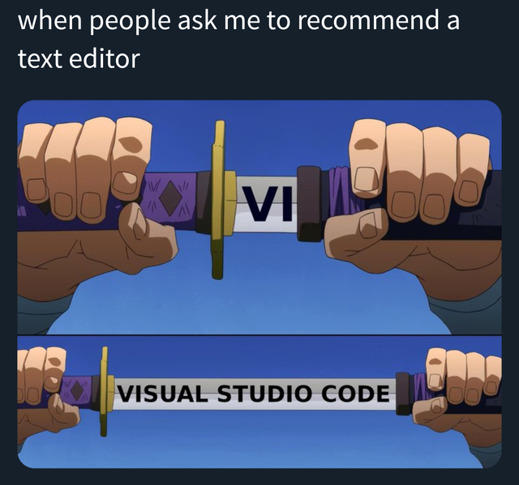
Follow along
Web Browser
Grab a text editor
Visual Studio Code
Or
Notepad++ (Most lightweight)
Atom
Sublime Text
Stop me if I’m going too fast
Notes:
Give everyone about 5 minutes

Slide 3
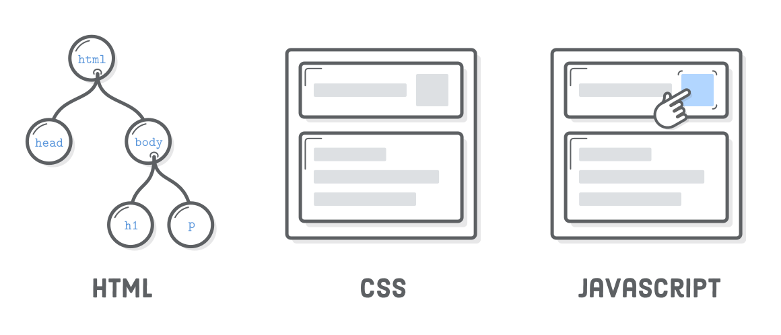
What is html, css, javascript
Structure
Formatting
Interaction
Notes:
HTML is the structure of the webpage
CSS is the design of the webpage
JavaScript is the engine of the webpage

Slide 4

Why learn these things?
Web apps are a staple for our job
Basic HTML/CSS knowledge is essentially an expectation in the industry.
JavaScript frameworks for EVERYWHERE
Front-end
Back-end
Mobile
Desktop, etc.
Notes:
A lot of applications in the industry are web apps.
Basic HTML/CSS knowledge is essentially an expectation in the industry.
You can develop cross platform mobile apps with HTML/CSS/JS (Ionic framework).
JavaScript frameworks EVERYWHERE
Front-end, Back-end, Mobile, Desktop, etc.

Slide 5
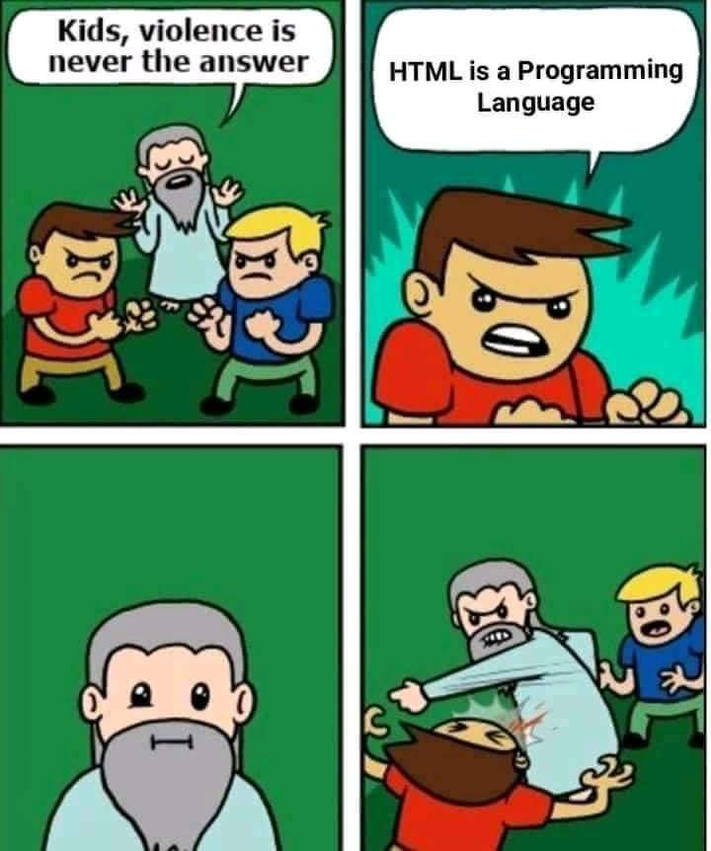
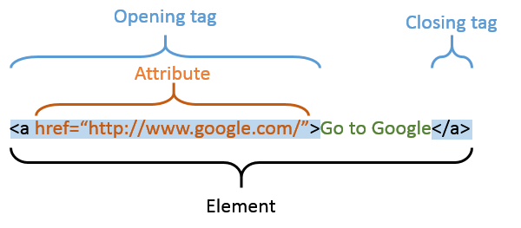
Starting off with HTML
Is NOT a programming language. - Markup Language
Web pages are made up of elements.
Elements are represented by tags.
You can change the attributes of the elements.

Slide 6
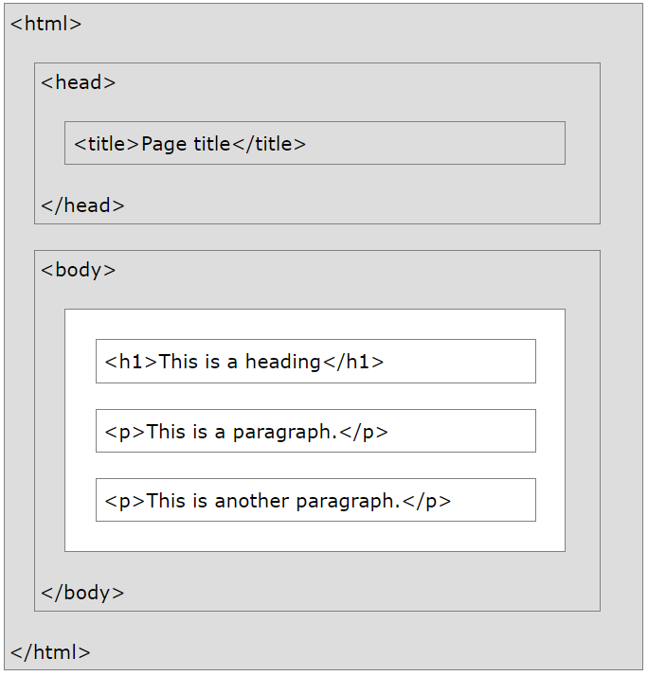
Notes:
Figure some stuff out for this

Slide 7
HTML Hands On

Slide 8
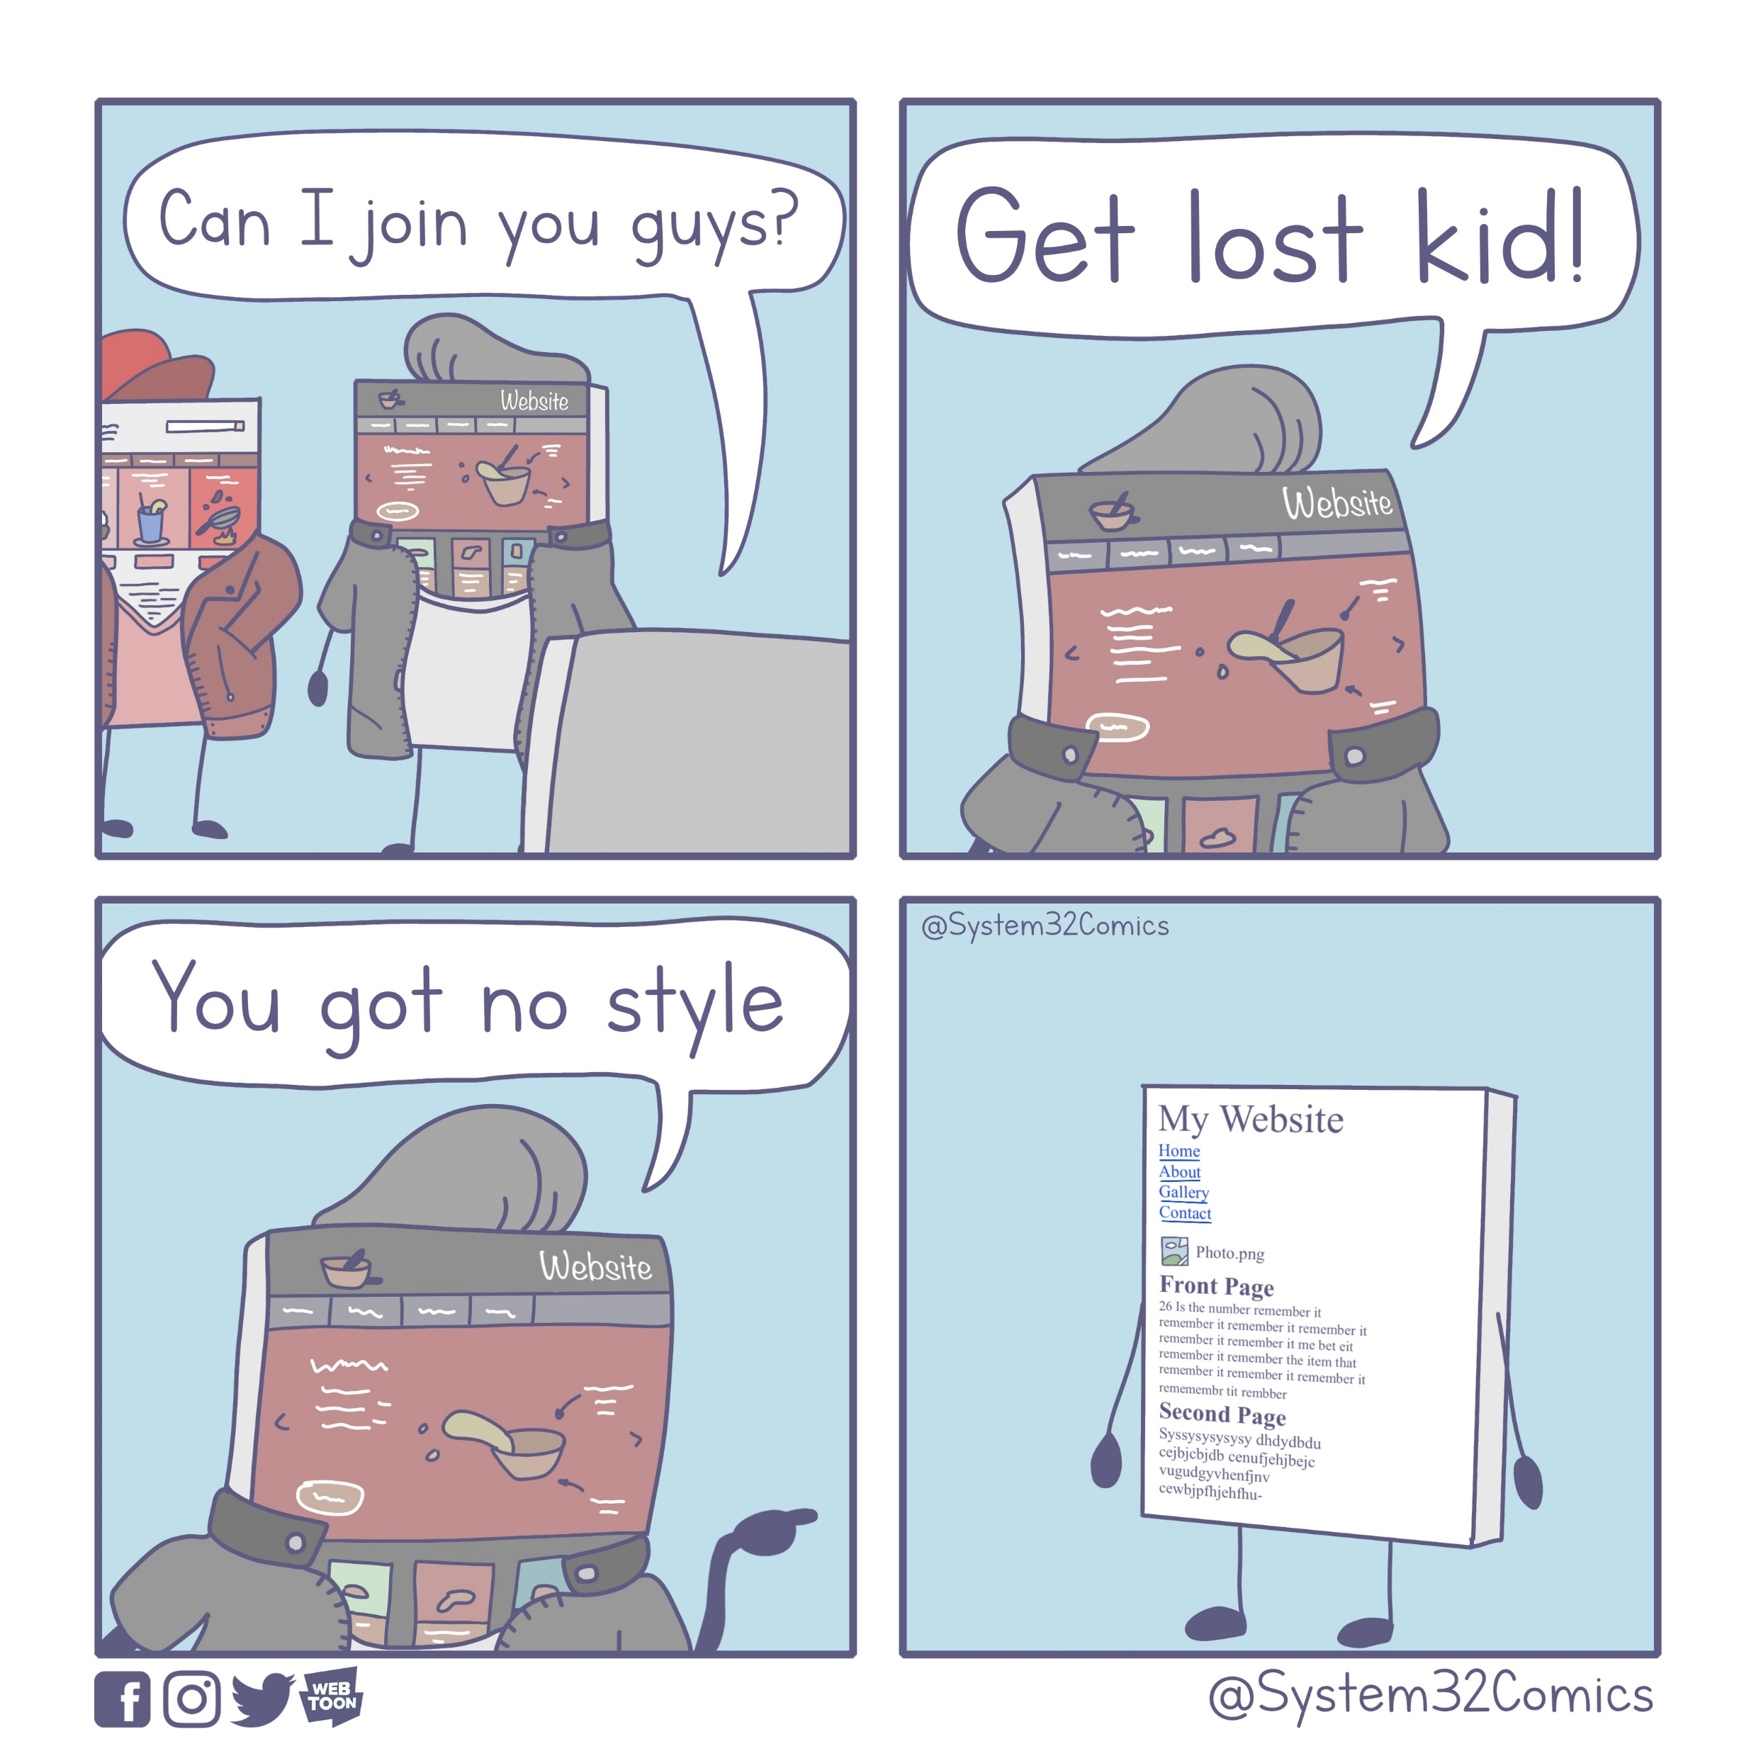

Slide 9
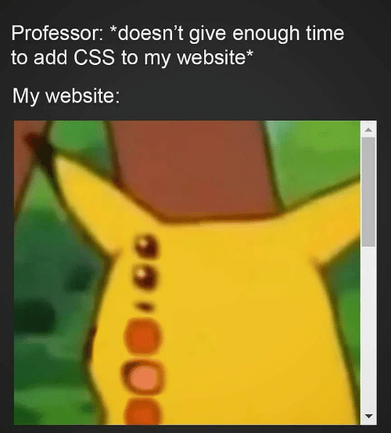

Styling: CSS and Selectors
CSS: Style sheets that make your webpage pretty!
Colors, Sizing, Positioning, and much more
3 Ways of Applying:
Inline – In the tag itself
Internal – In the HTML doc
External – In a separate file
Inline styling

Slide 10
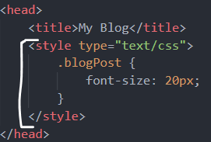
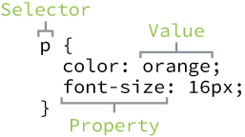
Applying CSS with selectors
Internal styling
Most CSS will be Internal or External
Selectors can be:
Elements
Classes (.)
Ids (#)

Slide 11
CSS Hands On

Slide 12
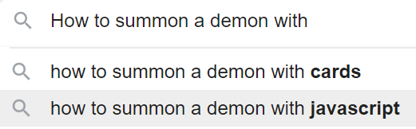
JavaScript
This is the engine/organs of your webpage
Similar syntax to Java
Interpreted programming language

Slide 13
JavaScript Hands On

Slide 14
Next steps

Slide 15
Addition Resources
Best way to master something is make your own project
Resources
W3 Schools: https://www.w3schools.com/html/default.asp
MDN web docs: https://developer.mozilla.org/en-US/
Read about accessibility standards
https://validator.w3.org/
Fonts: https://fonts.google.com/

Slide 16

Do you hate css like me?
Most widespread used CSS Framework
https://getbootstrap.com/docs/4.0/getting-started/introduction/

Slide 17

JavaScript frameworks
ReactJS https://reactjs.org/
Create reusable components with JavaScript
Extremely popular for front-end development
Other Popular Frameworks
AngularJS https://angular.io/
VueJS https://vuejs.org/

